Slide 1
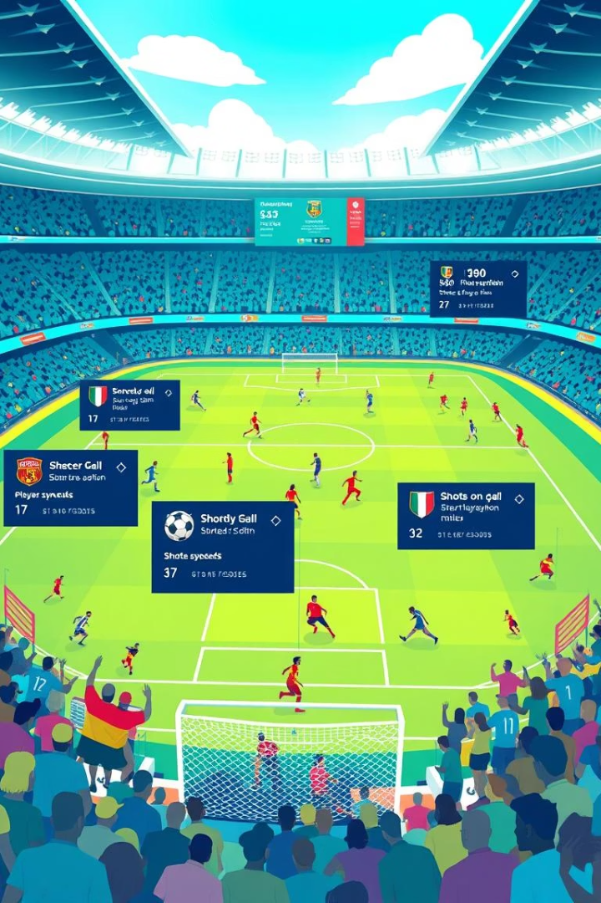
European Soccer League's Statistical Visualization
Team Members:
Shylendra Sudamani
Sarthak Acharekar
Shreyash Tiwari
Course: CIS 568 - Data Visualisation

Slide 2
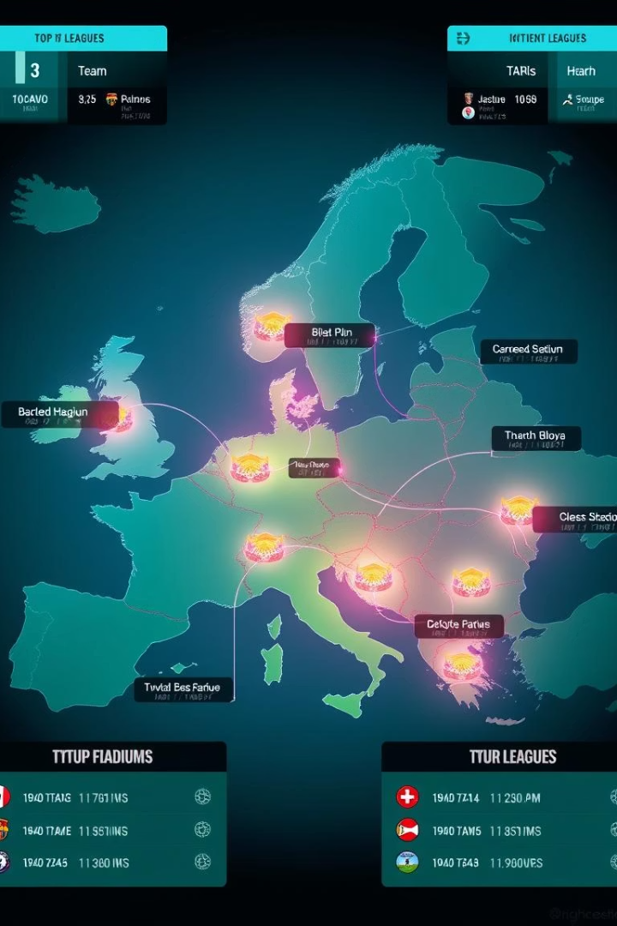
Introduction to the Visualization
What
The project visualizes major European football leagues on an interactive map and allows head-to-head team comparisons. It provides dynamic insights into stadium locations, team performance, and historical match results.
Why
Visualization simplifies complex football data, making it easier to analyze and understand team dynamics, geographical distribution, and match history. It enhances engagement with a user-friendly, interactive interface..
How
Leaflet.js creates the interactive map, while D3.js handles dynamic data updates and team comparisons. The project is built using HTML, CSS, and vanilla JavaScript for smooth, responsive performance..
Task
The project successfully delivers interactive and insightful visualizations, enabling users to explore football leagues and compare teams efficiently. The interface is responsive, easy to navigate, and visually appealing..

Slide 3

Visualization Showcases
Interactive Football League Map
Head-to-Head Team Comparison

Slide 4
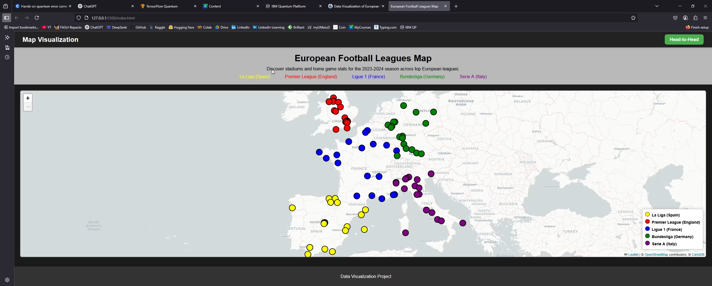
WORKING VIDEO OF THE DATA VISUALISATION PROJECT

Slide 5
Key Findings
Geographical Distribution of Teams
League Representation
Head-to-Head Insights
User Engagement
Interactive features, such as clickable markers and dynamic data updates, boost user engagement and simplify the exploration of football statistics.
The map highlights the concentration of clubs across Europe, revealing regional dominance in leagues like La Liga, Premier League, and Serie A.
Color-coded markers distinguish teams by league, allowing easy identification and understanding of club distribution across Europe.
The comparison tool provides instant performance metrics, showing wins, losses, and draws in historical matchups between teams.

Slide 6

Potential Improvements
Expanded Features
Add advanced filters and real-time data updates.
User Interaction
Enhanced responsiveness and customization options.
Additional Data Layers
Integrate new metrics and cross-data comparisons.
Future Iterations
Plan regular updates based on user feedback and trends.

Slide 7

THANK YOU
Team Details
Shylendra Sudamani : 02187097
Sarthak Acharekar : 02166623
Shreyash Tiwari : 02179058

